Slide 1


scratch.mit.edu
Tonight, an Hour of Code
http://HourOfCode.com/co
Then, a quick introduction to

Slide 2
What is Scratch?
A very kid-friendly programming environment.
Snap-in blocks. Minimal typing (mostly numbers).
Hour-of-code uses this
What can you make? Nearly anything!
·Stories
·Art (your projects tonight)
·Games (lots of games!)
·Edu-ware (‘learn to draw anime’)

Slide 3
Some examples
Here’s a silly “story” project
http://scratch.mit.edu/projects/16501532
Games often have stories.
Angry Birds: http://scratch.mit.edu/projects/2294898/
Art is fun
Dragon Maker: http://scratch.mit.edu/projects/10695893/
Our last project tonight: http://scratch.mit.edu/projects/12135243/

Slide 4
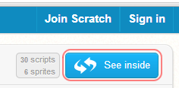
Scratch: Projects
You can play with & look at 1000’s of projects
Go To scratch.mit.edu
You can ‘See Inside’ every
project that is shared
Let’s learn about drawing

Slide 5
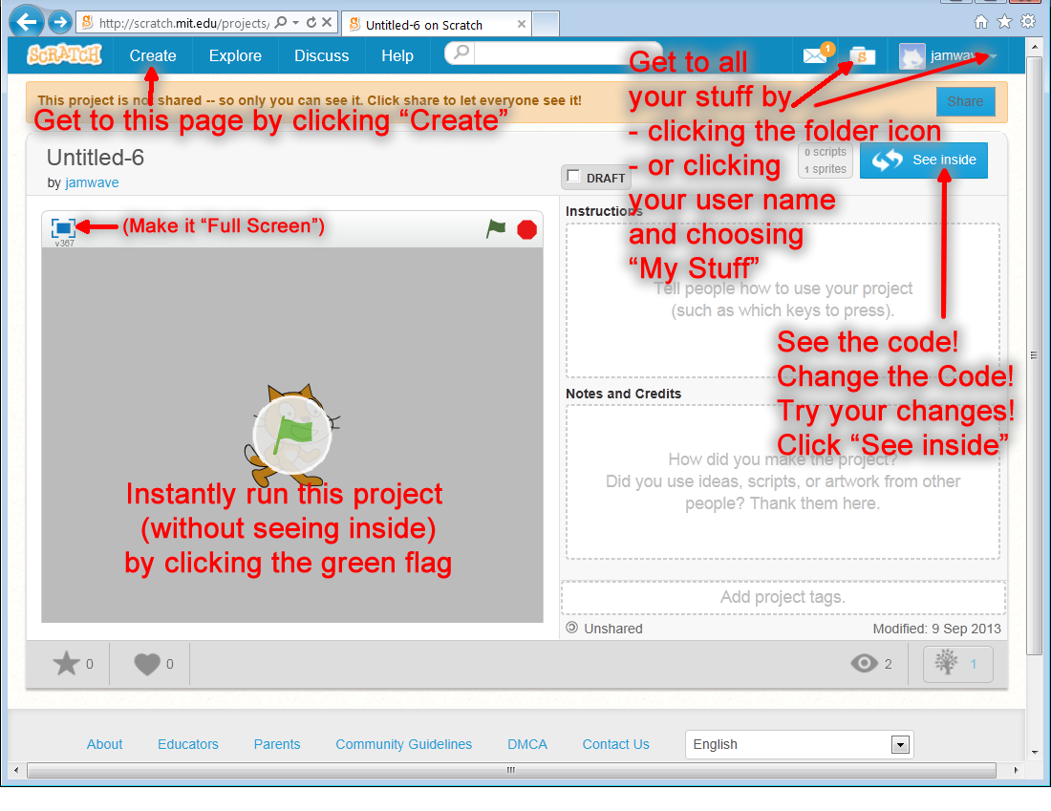
Welcome to scratch.mit.edu

Slide 6
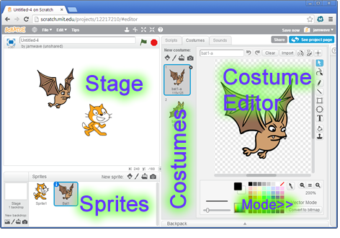
Draw, choose or import “Sprites”
Tip: sprites can have multiple costumes. If you flip between them, you can create animation

Slide 7
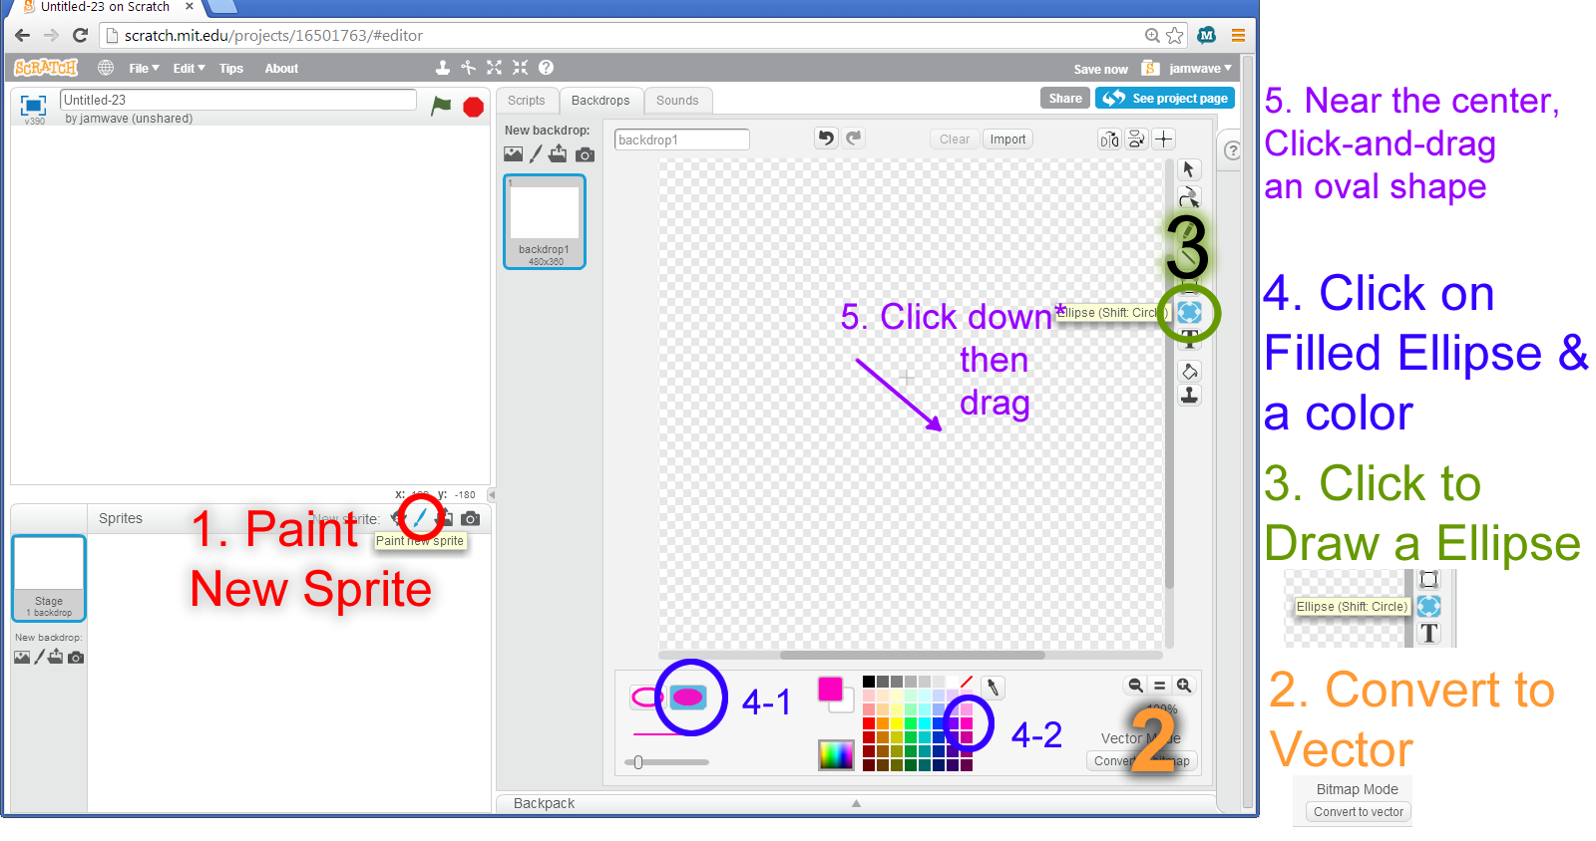
Ready, Set, Draw!
Walkthrough at http://youtu.be/PX58X3sU6kg

Slide 8
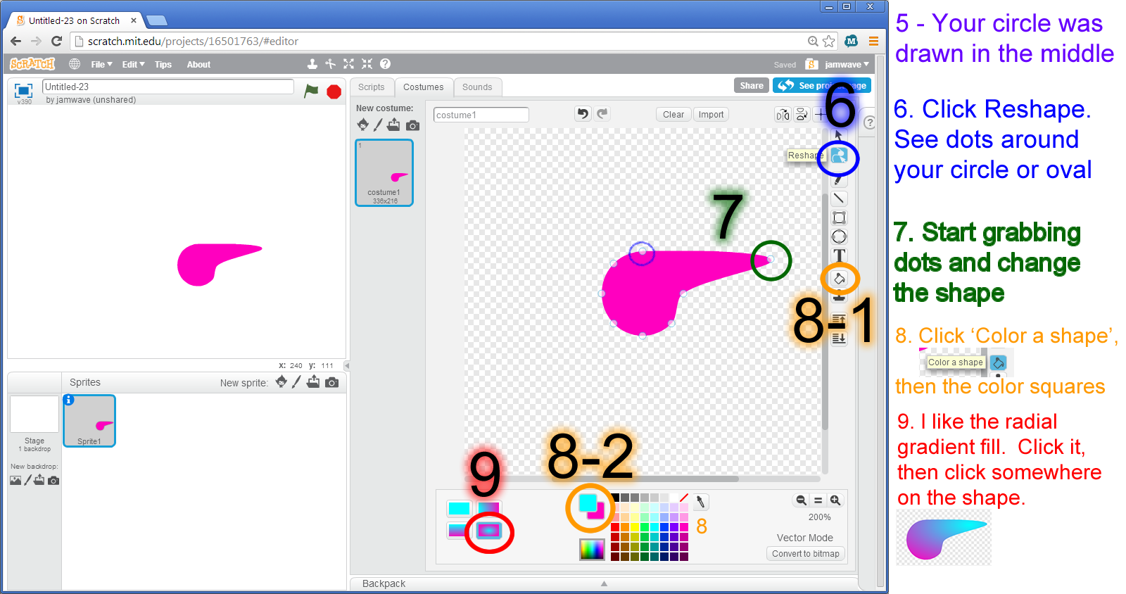
Make it interesting!

Slide 9
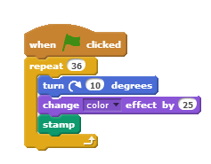
Now, Really make it interesting!
Click the Script tab
Drag these commands.
You can find each in their color-coded category
Mix it up a bit (try other degrees, color effects, or try to add motion!)
Walkthrough at http://youtu.be/ldL9wuIW5OE

Slide 10
A few more examples
A silly chase scene http://scratch.mit.edu/projects/11556556/
Pong http://scratch.mit.edu/projects/12136434/

Slide 11
Tips!
Log in to Save your scratch project
Complete your Hour of Code puzzles at
learn.code.org/hoc/##
(where ## is the last puzzle you worked on
Hope you come again!

Slide 12
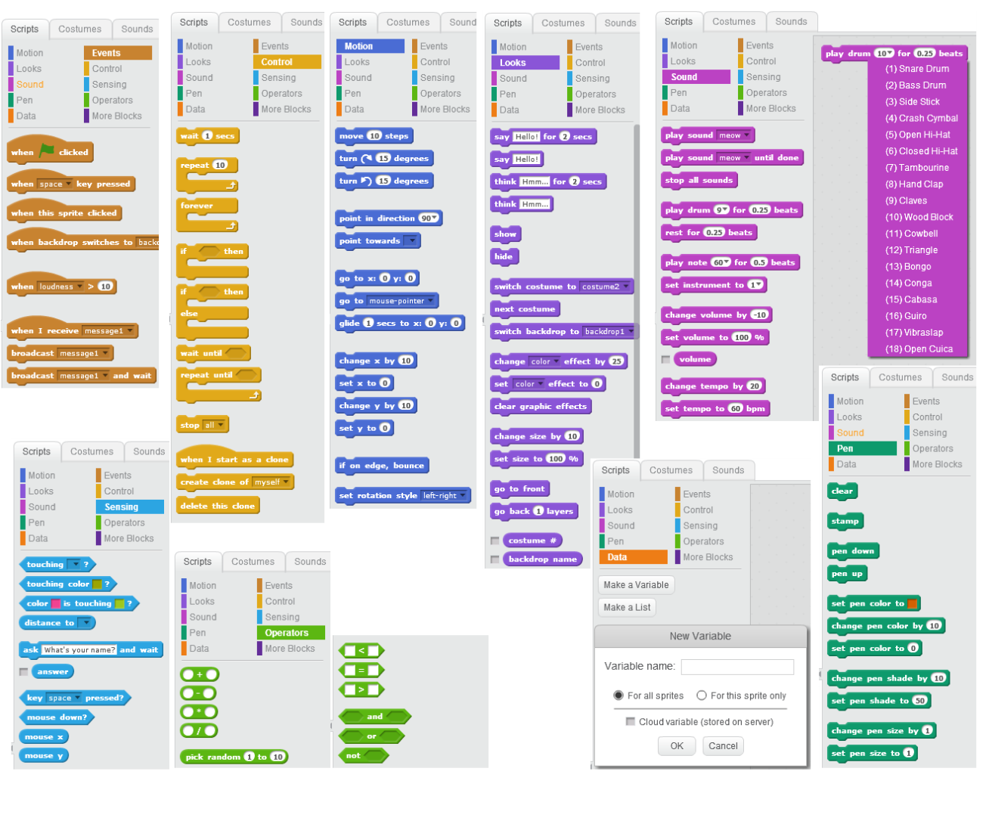
All the commands!

